Slide 1
205 Jan 12, Class 5
Chapter 4: Experimental Procedure
Participant variables and random assignment
Demand characteristics and participant bias
Controlling for experimenter bias
Craik & Tulving (1975)
Review of prior research on “levels of processing”
Chapter 6 preview
APA writing, brief overview and Methods section

Slide 2
Implicit bias research
Bargh, Chen & Burrows (1996) found that activating stereotypical concepts led to direct changes in behavior
Experiment 1: participants primed with the concept of rudeness interrupted the experimenter
Experiment 2: participants primed with an elderly stereotype walked more slowly after the study

Slide 3
“Rude” Priming manipulation
Participants asked use the five words listed to construct a grammatically correct four-word sentence as quickly as possible.
E.g., "he it hides finds instantly.“
15 of the 30 items contained words related to the trait in question.
For the rude priming version, the critical priming stimuli were: aggressively, bold, rude, bother, disturb, intrude, annoyingly, interrupt, audaciously, brazen, impolitely, infringe, obnoxious, aggravating, and bluntly
For the polite priming version, the stimuli were: respect, honor, considerate, appreciate, patiently, cordially, yield, polite, cautiously, courteous, graciously, sensitively, discreetly, behaved, and unobtrusively

Slide 4
Dependent variable
Participants told to come find the experimenter down the hall after completing the 5m sentence construction test
Experimenter and confederate pre-arranged to be in conversation when the participant emerged
Stopwatch started
Conversation continued until participant interrupted (10 min max)
Waiting time measured
Rude condition, M = 326 s
Polite condition, M = 558 s

Slide 5
Walking speed
Priming is sentence construction with words related to elderly/aging
Walking speed down a hallway measured after priming task
Bargh, Chen & Burrows (1996) found slower walking measured with stopwatch by experimenter
Doyen, Klein, Pichon & Cleeremans (2012) found no effect with automatic timing measure (sensors)
Further found that with stopwatches, the effect depended on research assistant training knowing the hypothesis (or reversed)
Implicit bias in experimenters
“Rosenthal effect”
Implicit experimenter bias influencing the dependent measure

Slide 6
Avoiding experimenter bias
Use automatic measures whenever possible
When subjective judgments are required, use “independent raters”
Emotional reactions such as laughing
Looking direction in infant research
“Double blind” procedures
Even the experimenters do not know the condition of the IV
Common in medical intervention research, e.g., drug studies
Randomized Clinical Trials (RCT)

Slide 7
You are doing a study at a local school. Because of the way things area scheduled, you can have one small testing room in the morning and another much larger testing room in the afternoon. If you have two treatment conditions (A and B), how can you assign subjects to the testing rooms so that the type of room will not lead to confounding your experiment?

Slide 8
Dr. L is planning a large scale learning experiment. He would like to have 100 rats in one treatment group and another 100 in the other group. Because he needs so many rats, he says, “Well, I can’t test all these animals by myself. I’ll ask Dr. P. to help me. He can run the animals in the one group while I test the animals in the other group.”
Knowing what you know about experimenter bias, is Dr. L’s solution a good one? What can happen if one experiment tests all the subjects in one group while another tests all the subjects in another group?
Given what you know about balancing procedures, work out a better plan for Dr. L.

Slide 9
Craik & Tulving (1975)
10 experiments
Multiple replications
Value of different approaches to IV and DV
Writing and presentation, methodological detail, results
This is an older variant of APA style
Your report should be in modern style

Slide 10
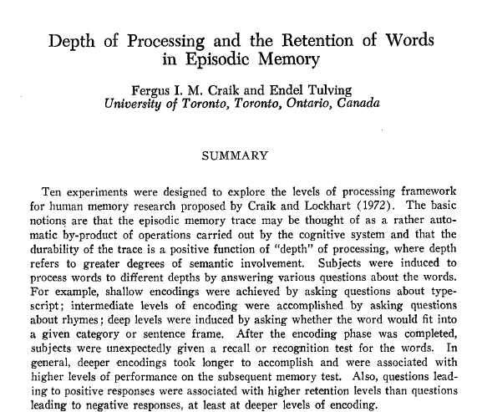

Slide 11
Q1
In Experiment 1, how many levels of the IV were used?
What was the DV measure of memory?

Slide 12
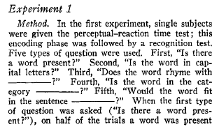
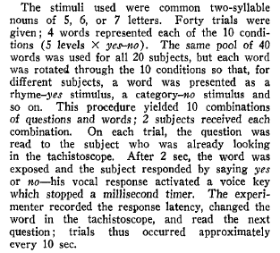
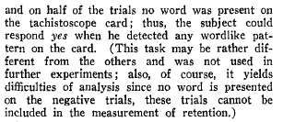
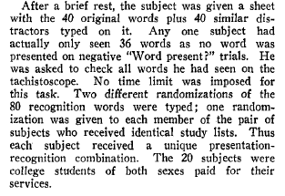
Exp 1 Methods
Materials
Procedure

Slide 13
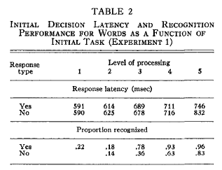
Exp 1 Results

Slide 14
Q2
Experiment 5 is carefully designed to address what confounding alternative hypothesis?
To do so, what aspect of the IV is made as constant as possible?

Slide 15
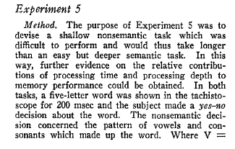
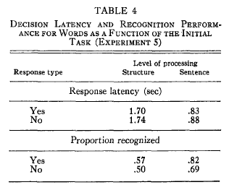
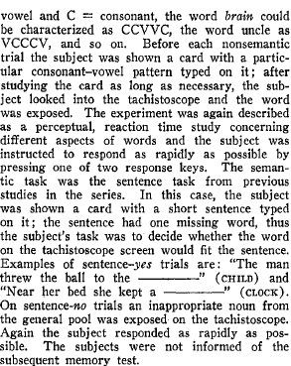

Slide 16
Q3
In what way was Experiment 9 similar to our in-class experiment?
Identify some methodological differences

Slide 17
Reporting on Experiment 1
Due on Friday Jan 19
Monday: data analysis
Wednesday: Data analysis & APA format
Friday: ask questions
Double-check, proofread, ask
Second writeup extends this one
First report has simplified requirements
You will have an opportunity to make corrections

Slide 18
Chapter 6: APA Report Sections
Abstract
Very concise summary, ~200 words
Introduction
Construct, background, hypothesis
Methods
Participants, materials, procedure
Results
Figure
Discussion
Conclusion, interpretation, limitations
References

Slide 19
APA Methods Section
Participants
Materials
Procedure
Enough detail that somebody who was not here could run the study themselves to replicate the findings

Slide 20
Experiment 1 Methods information
Participants
48 students from two Research Methods class sections
Materials
A set of 60 words was used for the study and test stimuli. Words were selected to have a written frequency of 30-80 per million and to be 5-8 letters in length.
Procedure
4s time per word to rate (automatic advance)
“For each word, rate how much you like the word on a 1 to 5 scale. 5 means you like the word very much and 1 means you dislike the word very much. Indicate your rating with keyboard or mouse.”
“For each word, count the number of vowels in each word. Enter the number with keyboard or mouse"
3m delay period completing trivia questions
60 item post-test, 30 old, 30 new

Slide 21
Exp 1 Report requirements
Abstract
Short
Introduction
Short
Methods
Complete and detailed
Results
Complete and detailed (still short)
Figure & caption
Discussion
Short
References

Slide 22
For Wed Jan 17
Chapter 5: Statistics 1
Statistics for Experiment 1
Descriptive statistics using data in a spreadsheet (Excel)
Inferential statistics using R
Making a figure to illustrate the results
Data and instructions for carrying out the analysis posted on Canvas
You are doing the Results section for the report. We will go through the process quickly in class on Wed to ensure everybody has correct numbers.

